Slide 1
Netflix Data – by Yaqoub Al Qaoud
Capstone Project for Data Visualization w/ Python Intensive
Cohort March-5-2017

Slide 2
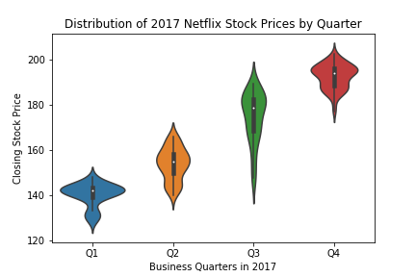
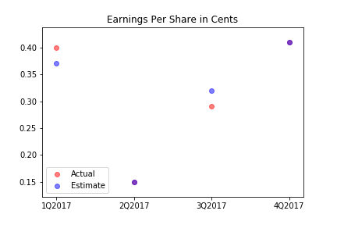
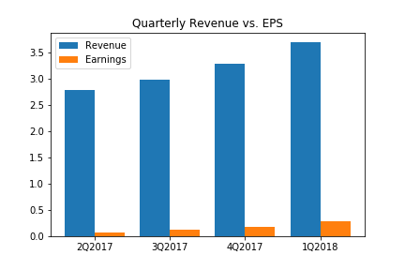
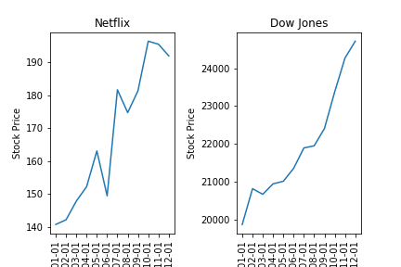
Project Objective
In this project, I was working as an data visualization developer at Yahoo Finance to help their analysts on the visualizations below. We worked on Netflix stock, which was so much fun to witness, and beneficial at the same time.

Slide 3
Distribution of Netflix Stock Prices in 2017
Key points:
Clearly 2017 was a bullish year for Netflix stock with a steady uptrend.
Price ranges in Q1 between 125 and 150, Q2 between 140 and 170, Q3 between 140 to 200, and Q4 between 175 to 210.
Lowest price at aprproximately 125, amd highest at around 215
Q1 is the least volatile with price hanging at 140ish most of the time.
Q3 is the most volatile as we see the talles violin.

Slide 4
Netflix EPS: Actual vs Estimate
Key points:
Very minor discrepancies in Q1 and Q4 of only around 3 cents per share.
Estimations were correct in both Q2 and Q3.
EPS took dramatically decreased in Q2 of 2017 compared to the previous of Q1.
However, EPS had a steady growth in Q3 and Q4 to surpass Q1’s earnings.

Slide 5
Netflix: Revenue vs. EPS
Key points:
We can see a steady, compounded quarterly growth in revenue over the 2017’s fiscal year.
From the graph, we can see that there is a direct correlation between revenue and earnings.
We could say that earnings represents a percentage of around 5% of revenue across the four quarters.

Slide 6
2017: Netflix vs. Dow Jones
Key points:
On average, Netflix trend has the same steepness as Dow Jones, however had corrections in May, August, and December.
Netflix is obviously the volatile one of the two, which is highly likely as it is a stock compared to an index that his heavier and slower.
As noticed, there is a big difference in the prices, which is normal because Netflix is a company, while Dow Jones’s price represents the weighted price of various large companies.

Slide 7

Thank you! ☺

